Slide 1
Bayesian data analysis: Part 2
Alan Pickering
Dept. of Psychology
Goldsmiths, University of London
a.pickering@gold.ac.uk

Slide 2
Preliminaries
All the materials for this set of workshops/tutorials are in an open access repository
https://github.com/Alan-Pickering/Bayesian-data-analysis-teaching
You should review the slides for part 1
Bayesian Data Analysis Part 1.pptx
before going through this set of slides (part 2) for the first time.

Slide 3
Overview
Model fitting
More on Bayesian Model Comparison

Slide 4
Uses of Bayes’ Theorem: Part 2
Using Bayesian methods to evaluate the fit of models to data (Bayesian Model Comparison)
Use of Maximum Likelihood Estimated models to generate Bayes factors comparing two models

Slide 5
Bayesian Model Comparison
Uses Bayesian methods to evaluate the fit of a model to the data, in comparison to the fit of a rival model
There are several methods for doing this. We’ll show how to use the Bayesian Information Criterion (BIC) and Bayes Factors
You use this process when executing Bayesian statistical tests (comparing alternative vs. null hypothesis)

Slide 6

How do we fit a model to the data?
We find the estimated parameters ($\hat{θ}$) of the model that are associated with the maximum likelihood (L) of the data (y) given the model
i.e. we maximise $L(\hat{θ}|y, M)$
MLE is usually done using standard iterative fitting/optimisation routines but for an example where it can be computed directly see the tutorial file in the Github repository:
maximum likelihood estimation.pdf

Slide 7
Maximum Likelihood Estimation (MLE): 1
These are data from 100 left-handed throws at a dartboard, coded as to whether they hit anywhere on the scoring part of the board
My simple model is that there is a parameter p which captures the probability of my hitting the board with left-handed throws (I am right-handed)

Slide 8
Maximum Likelihood Estimation (MLE): 2
0.6 is the ML estimate of parameter p for these data;
See tutorial file above for details

Slide 9
Maximum Likelihood Estimation (MLE): 3
An excellent “explainer” about maximum likelihood estimation is in the following blog:
https://fabiandablander.com/r/Regularization.html
The relevant sections of the blog are from “Modelling Coin Flips” to “Classical estimation”

Slide 10
Bayesian Information Criterion (BIC)
MLE
N= # data points
K = # parameters
Farrell, S., & Lewandowsky, S. (2018). Computational modeling of cognition and behaviour. Cambridge, England: Cambridge University Press.

Slide 11
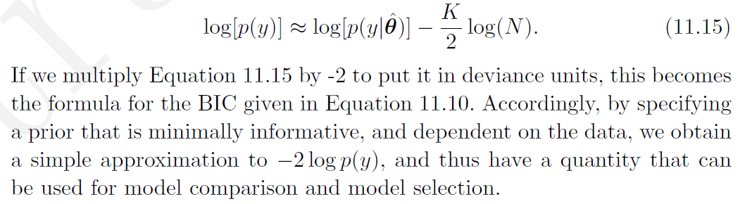
After some assumptions, and a bit of algebra….
So, BIC gives an approximate estimate of log(p(y))
Farrell, S., & Lewandowsky, S. (2018). Computational modeling of cognition and behaviour. Cambridge, England: Cambridge University Press.

Slide 12

And finally to Bayes Factors… $${BF}_{M1 vs M2}=\frac{exp(−0.5∗BIC1)}{exp(−0.5∗BIC2)}$$

Slide 13
Analysing some data: 1
The data are in an SPSS format file, in the Github respository:
darts study.sav
Here’s a key cross-tab from that file
 |  | hitboard
 |  | 1=yes | 2=no | Row Totals
Throwing Hand | Right (=1) | 40 | 10 | 50
 | Left (=2) | 20 | 30 | 50
 | Column Totals | 60 | 40 | Grand Total=100

Slide 14
Analysing some data: 2
Read the tutorial file in the Github repository for details of the calculations: maximum likelihood estimation.pdf
Under model 1 we have a single parameter, p, capturing the probability of hitting the scoring area of the dart board
We find that the log-likelihood of model 1, LL1 = -12.764
Under model 2 we have two parameters, p_{L} and p_{R}, capturing the probability of hitting the scoring area of the dart board with the L and R hands respectively
We find that the log-likelihood of model 2, LL2 = -4.135

Slide 15
Analysing some data: 3
Our key question is to try to determine which model fits the data better, bearing in mind that one model has 2 parameters and the other has only 1.
In general models with more parameters fit the data than models with fewer, but we strive for parsimonious explanations so we must assess whether the additional parameters achieve a worthwhile enhancement of the fit
We will explore this using traditional statistics and then via Bayes factors

Slide 16
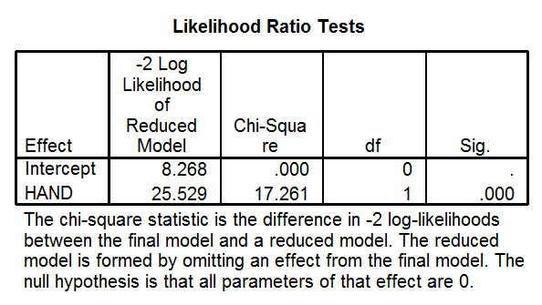
Analysing some data: 4
Read the tutorial file for how to analyse these data traditionally using logistic regression in SPSS or JASP. The results of a likelihood ratio test shows that the effect of hand cannot afford to be omitted in modelling these data:-
This significant result means that we can reject the null hypothesis which ignores the hand of the throw

Slide 17
Analysing some data: 5
Using the formulae given above you can also compute an estimate of the Bayes factor for model 1 vs model 2, BF₁₂
If you want an easy way to do this you can use my Matlab programme called MLE_to_BF.m
From the data, BF₁₂ has a value of 0.0017884, which means the evidence favour model 2 (the more complex model) over model 1.
How strongly do the data favour model 2? On the next slide model 2 is represented by H₀ and model 1 is H_{A}

Slide 18
Interpreting Bayes factors, BF_{A0}
Our Bayes factor calculation provides “decisive evidence” in favour of model 2

Slide 19
Analysing some data: 6
How about if we used JASP to conduct a Bayesian logistic regression on these data to test the effect of hand?
Sadly this procedure isn’t available in JASP yet ….
but the method just given in these slides, is a way to carry out such an analysis in this simple case using a factor (Hand of throw) as a predictor.

